Slide 1
Meauxmentum Scholar Reflections: Final Workshop May 21, 2025
Jeffery Galle, Ph.D.
Creative Engagement with Faculty
ellag55@gmail.com
https://Jgalle.com (website),
Notes:
Welcome everyone! Thank you so much for coming. Today I am delighted to have a number of Meauxmentum Scholars to share their experiences this year, and the topics they will explore should support your addressing the topics as you finalize the Reflection. So thanks to them; introductions to be made soon.
We are 12 days from the submission deadline so a huge thanks to all MS. At the end of the workshop, I will provide the submission link, and invite you to send me drafts and questions up to and including our submission deadline. Today’s workshop, is intended to speak to all three tasks—drafting, revising, and editing the reflection. Because we’ve discussed drafting twice, we’ll begin today with revising tips and strategies.

Slide 2
Today’s Tasks
To discuss tips for revising a full draft of the reflection
To listen and respond to MS speakers as they describe their experiences this year.
To host a Q and A, review materials and the process for drafting the Reflection.
Notes:
Today we’ll work in somewhat reverse order (from revising/editing, to speakers recounting their work, and then to writing the draft, b/c we’re assuming most will be working with a draft in hand already, but if not, we’ve got you covered.
So wherever you are at the moment, please engage with us in our last workshop of the year.
Now, to begin please open your current draft Reflection and go with me through several quick points.

Slide 3
I. Revising the Discovery Draft
We must acknowledge that we continually revise as we write, so revising is not an entirely separate process.
Still, there are many several ways to improve a full or partial draft.
Today, we will consider the Lead, Close, Anecdotes, and Persuasive statements as finishing touches to a strong piece of writing.
Notes:
Revising. What does that mean? Sentence grammar check? Running the document through a program, tool, or AI? In the old school way, I would maintain that a great deal can be learned the second time through.
If all writing is a kind of faith, as Donald Murray attests, then revising is working to get at the meaning.
Revising means to improve what is actually ON the page AND for us today to improve how we get IN (the Lead) and out (the Close), how we interject little clear stories (anecdotes), and how we convince readers to believe us.

Slide 4
Revising the Discovery Draft
‘Our best writers report that they work from the specific to the general’ (Murray 53).
And Eudora Welty declares, “What discoveries I’ve made about writing begin with the particular, not the general.”
So the famous lead by Dickens generalizes after a close examination of the particular:
“It was the best of times. It was the worst of times.”
(Tale of Two Cities, Dickens)
Notes:
Full disclosure: Murray’s A Writer Teaches Writing was one of the texts I used in teaching expository, nonfiction writing to upper level and graduate students. I love the book although it’s probably now considered passe. So what does either the Murray or the Welty statement mean to you: discoveries about writing begin with the ‘PARTICULAR’ not the GENERAL. [unmute or type in the chatbox. And some first lines are etched in our memory, as for me are the first two lines of Tale of Two Cities. First lines are important and possibly memorable.
But here’s the thing: reflections are an important kind of nonfiction, so it’s good writing sense to spend time crafting a good lead, an appropriate close, anecdotes and persuasive statements?

Slide 5
What They’re Saying: FLCs
“The outcomes of implementation science confirm that FLCs provide the most effective educational development programming for implementing evidence-based interventions and innovations in teaching and learning in higher education.”
[from Miami U page]
https://miamioh.edu/centers-institutes/center-for-teaching-excellence/faculty-learning-communities/index.html#:~:text=A%20faculty%20learning%20community%20(FLC)%20is%20a,FLC%20model%20was%20initiated%20at%20Miami%20University
Notes:
For your lead, close, and anecdotes, consider a succinct quotation on topic or a quote from another source that applies.
If you are looking for generally insightful comment about the FLC as a structure, quotes like this one on the Miami University site makes a strong case for the FLC as providing the best implementation of evidence-based interventions and innovations.

Slide 6
What They’re Saying: Small Teaching
Lang explores exercises in three cognitive categories – knowledge, understanding, and inspiration. Penn State’s Behrend Center points out, “We can also look at the small changes as techniques that can be implemented into individual class sessions at the beginning (in the first fifteen minutes), in the middle, or at the end.”
“Small Teaching” Tips – The Beginning, Middle, and End of Class .Aug 9, 2021 Resources, Teaching Tips
Notes:
Find a good insight from your author—Lang, Winkelmas, Kuh (HIPS), or another authority such as the quote above on Small Teaching.
So again: The Lead is your first sentence, perhaps two. The Close is the way you end the reflection, often the first or last sentence of the last paragraph.
Anecdotes give image and action to the paper. A Persuasive statement capture an essence of what you are arguing or pointing out.

Slide 7
Revising the Discovery Draft
Lead from published Reflection: “When the SGSC Chancellor’s Learning Scholars issued the invitation to faculty to join either a Mindset or Small Teaching Faculty Learning Community, we had no idea that Small Teaching would be so appealing.”
A close from a published reflection: “I aspire to be a better teacher and I want my students to have meaningful and significant learning experiences they can still remember tens of years into their own careers.”
Notes:
Here are a couple more examples.
Lead is Selby’s 2021.
Close is from Whipple, part of Selby’s community.

Slide 8
What They’re Saying: TiLT
“By clarifying assignment expectations, students are more likely to understand what is required of them, which can lead to improved academic performance. Research has shown that TILT can reduce the performance gap between underrepresented students and their peers, promoting greater equity in education.”
[from Dakota State’s T and L website: https://support.dsu.edu/TDClient/1796/Portal/KB/ArticleDet?ID=148389#:~:text=The%20TILT%20(Transparency%20in%20Learning,constitutes%20excellence%20in%20the%20task. ]
Notes:
Would this qualify as a Persuasive Statement? Could something like this make a good lead or close?
Perhaps evidence of this sort simply adds substance to your paper.

Slide 9
Revising the Discovery Draft
An example anecdote:
“During the workshop itself I was drawn towards the teaching modalities of Transparency in Teaching and Learning (TILT) and high impact teaching practices.
On my drive back home, I decided my FLC was going to focus on TILT as a high impact teaching practice. The concept of making learning transparent appealed to me.”
Notes:
Devi Akella, Albany State, relates how and why she selected her topic.

Slide 10
Revising the Discovery Draft
A persuasive statement:
“ I was intrigued by Dr. Frank Williams’ interactive activity of giving poor instructions on how to build a paper airplane and then realizing how frustrating it must be for students to receive poorly written instructions for an assignment.
Furthermore, TiLTing assignments makes it easier for grading by the instructor as well.”
Notes:
Goldsberry’s Reflection, Georgia College

Slide 11
What They’re Saying: HIPS
Scholars at the Ohio State U teaching site point out, “When thoughtfully designed and administered, HIPs boost student engagement, a key moderator for student success.”
[from https://teaching.resources.osu.edu/teaching-topics/high-impact-practices-enhancing ]
Note: Our work with the 8 Key Elements of HIPS also ensures individual HIPS will be ‘thoughtfully designed and administered.’
Notes:
With our work with the 8 Key Elements of HIPS well done, our MS could easily add references HIPS well done by including the 8 Key Elements

Slide 12
What They’re Saying: AI, Online, SoTL, Course Design
Check out the work of Nirmal Trivedi, Beyza Lorenz, Denise Domizi, or myself as sources for
Leads,
Closes,
Anecdotes, or
Persuasive Statements
Notes:
For any Lead, Close, Anecdote, or Persuasive Statement on one of our fall webinars, revisit sources included by our scholar presenters or those free resources from the January and February check-ins provide many wonderful places to search for quotes and anecdotes.
NOTE: See the Appendix slides of this slide deck contain references and links to these materials.

Slide 13
Summary: Revising and Editing Checklist
Improve the Lead, Close, and add Anecdotes, Persuasive Statements.
Bring into greater clarity my own creativity in course changes and application of them.
Finally, what to change/how to change the FLC members’ reflections?
Notes:
While we have focused on the elements of Revision of Lead, Close, etc, you can also revise by drawing attention to the creativity you used to make your course change with the pedagogical strategy.
So now with some distance from your original decision of course change, you can explain it more aptly or describe it to your audience,
You can also consider what you can do to improve the members’ reflections as well.

Slide 14
Thoughts, conversation, practice
Lead
Close
Anecdote(s)
Persuasive statement
Notes:
Which of these checklist items (or others) can be improved to develop your final draft? In two-three minutes we’ll report back.

Slide 15
II. MS Sharing Experiences
Alicia Book is an Assistant Professor in the College of Nursing and School of Allied Health at Northwestern State University.
Jennifer Lofton is an Associate Professor of English at Bossier Parish CC.
Melissa Madden is an Assistant Professor and the RN to BSN Program Chair at Louisiana Tech University.
Rogers Martin is an Instructor of mathematics in the College of Arts and Sciences at Louisiana State U in Shreveport.
Meredith McKinnie is an Assistant Professor of English in the College of Arts, Education, & Sciences at University of Louisiana at Monroe. Director of 1st Year Composition
Wendy Sonnier is an Assistant Professor of Business Administration at SOWELA TCC.
Notes:
Maybe STOP sharing so their cameras can take up the screen!

Slide 16
III. Q & A, MS Materials, Drafting review
♦ Questions for the Presenters or on the Reflection
♦ MS materials in support of the Reflection process
♦ Drafting the Reflection, a review
Notes:
After all presentations, return to SCREEN share and move to Part III.
Do we have questions for the MS presenters? What similarities do you find with your own FLC and pedagogical topic?

Slide 17
III. Q & A, MS Materials, Drafting review
♦ Questions for the Presenters or on the Reflection
♦ MS materials in support of the Reflection process
♦ Drafting the Reflection, a review
Notes:
After all presentations, return to SCREEN share and move to Part III.
Do we have questions for the MS presenters? What similarities do you find with your own FLC and pedagogical topic?

Slide 18
MS Materials: Year in Review
August Kickoff (full slide deck)
Worksheets: FLC Toolkit, Small Teaching Inventory, TiLT worksheet, HIPs the 8 Key Elements, and HIPS in individual courses
September 4 virtual makeup
Fall web 1: AI Uses & Challenges
Fall web 2: Teaching Online BP
Fall web 3: Scholarship of T & L
Fall web4: Course [Re]Design
MS 2025 Spring
January Check-in (2x)
February Check-in
March Check-in
April pre-Summit workshop
May Reflection workshop
Notes:
The content, presentations, slide decks of this MS year!

Slide 20
Other available materials: Class, Assignments, Experiential Learning
https://teachinginhighered.com/podcast/small-teaching-reprised/ Inside Higher Ed interview with Jim Lang after 2nd ed of ST published.
https://crln.acrl.org/index.php/crlnews/article/view/24768/32616 good survey, types, analysis
https://gcci.uconn.edu/2019/08/19/applying-james-langs-small-teaching-in-stem-classrooms/ applying ST in STEM courses
https://www.ala.org/acrl/publications/keeping_up_with/small_teaching ST in Information Literacy, a course example
https://cei.bd.psu.edu/2021/08/09/small-teaching-tips-the-beginning-middle-and-end-of-class/ ST for first 5, last 5, and middle pause work.
Notes:
This slide and the two next ones contain the links and sites for free resources on each of our topics/contexts.

Slide 21
MS materials: Kickoff slidedeck and recording as well as TiLT worksheet
Examples of Assignments, original and more transparent
Additional TiLT resources:
https://tilthighered.com/tiltexamplesandresources
[On the page, scroll down to ‘Example Assignments [more and less transparent]’
After reading several examples, consider how the TiLT framework of
Purpose, Task, and Criteria and revised language can apply to your assignments.
Notes:
With more than a dozen examples, faculty can read and analyze the choices that other faculty have made to make their assignment more clear.
Applying the TiLT framework—Purpose, Tasks, Criteria for evaluation—to other materials like syllabi, or perhaps group projects, or other faculty work too—can improve clarity of much of what students encounter.

Slide 22
https://www.aacu.org/trending-topics/high-impact AACU page
https://teaching.resources.osu.edu/teaching-topics/high-impact-practices-enhancing
The Ohio State University
https://www.tbr.edu/student-success/high-impact-practices Tennessee Bd Regents
Notes:
If one of the HIPS is your topic much is available for revision of your Reflection. . Much of the information is available online at places like the AACU pages, or institutional pages such as those at Ohio State, or even at other systems like Tennessee Bd of Regents which has been supporting work with HIPS for a number of years.
For your reflection, you can compare your FLC work to what others have done by using one or more of these sites.

Slide 23
III. Drafting
The zero draft: write with fingers on keyboard/pen on paper.
Afterward: read closely to discover the most impactful moments.
Moving from a zero draft to more structured work by using the information available to you.
Notes:
I think of the first draft as an act of faith. In A Writer Teaches Writing (2nd ed) Donald Murray declares ‘All writing is an act of faith’ (41).
The purpose of the first draft is ‘to discover’ he points out, calling this stage the ‘Discovery draft’ while some call it the Zero Draft. If this list looks familiar it’s that you have worked on this during the spring check-ins and the pre-Summit workshop.

Slide 24
Information for initial drafts
A chronological timeline:
Selecting the primary pedagogy
Recruiting and forming the FLC
Running it, the meetings, the changes
Following the 8 points of the Toolkit
MS must also make a decision about your members’ reflections—collate, edit, survey and then collate>
Notes:
In A Writer Teaches Writing (2nd ed) Donald Murray declares ‘All writing is an act of faith’ (41).
The purpose of the first draft is ‘to discover’ he points out, calling this stage the ‘Discovery draft’ while some call it the Zero Draft. If this list looks familiar it’s that you have worked on this during the spring check-ins and the pre-Summit workshop.

Slide 25
Reminder from the Kickoff and the Toolkit
“By the end of spring semester, each MS and FLC participant should be able to point to a change or innovation they have made in their classroom or on their syllabus to an assignment, activity, or course material as a result of their participation in the FLC.” (p. 1)
Notes:
Including reflections of members is required. At multiple meetings over the year, the question about members reflections has come up. So I place the answer here again as a placeholder. Toolkit, p. 1.

Slide 26
Ways to Showcase Member Reflections
Collating:
• Ashley Holmes (HIPS)
• Mary Hocks
• Gina Caison
• Matt Dischinger
• LeeAnne Richardson
• Michael Harker
• Melissa McLeod
Editing/summarizing:
Sarah Selby writes entire report (Small Teaching) and takes brief submissions from each member and summarizes while also adding good quotes.
Notes:
Sarah Selby’s reflection is on the Regents site as a good example of editing member reflections.
What many do is place member reflections after their own reflection.
What are some other alternatives? Baumgardner has sent out a survey and she will put together a narrative for by using the responses to the survey, for example.

Slide 27
Information for the Draft
♦ MS responsibilities, especially the 8 Toolkit topics
♦ FLC formation, scheduling and leading meetings
♦ Special circumstances in your situation
♦ Community and collegiality of members
♦ Course changes from the chosen topic(s)
♦ Results of course changes (if applied in spring)
♦ Sprinkling in images, anecdotes, illustrations.
Notes:
We write with information, data, facts—your responsibilities, how your FLC formed, your special circumstances or decisions, the course change(s), impact on student learning, and impact on your teaching both of the pedagogy and the FLC experience.
So if you are writing the draft, there is time to produce a great reflection and time to edit and revise.
What you’ve experienced is in your mind. Draw it out, make it your story.

Slide 28
8 Connected Topics for Reflections
A brief description of the original assignment, activity, or course material.
The purpose of the assignment, activity, or course material. (aka a TiLT term)
A description of the change or innovation you have made to the assignment, activity, or course material.
What you hoped to accomplish with this change or innovation (i.e. your goal).
Did this change or innovation meet your expectations?
What was the outcome for your students?
What will you retain or do differently next time?
What effect did your participation in this FLC have on your teaching?
Notes:
The Toolkit bullets focus on the course change from the original material(s), how it affected students, changes you will make in future, and generally how the FLC impacted you?

Slide 29
Changes: Assignments, Course, Curricular Materials
--Holmes: Writing Intensive assn, Community based project with nonprofit, site visit to legislature to observe, producing a persuasive letter/paper designed to support effort of nonprofit (Georgia State U)
--Employ ‘pause-predict-ponder’ to encourage constructive guessing (Ga Tech Engineering)
--Spliced in new topic in MGIS and away from block class (Dalton State Information Sys)
--Creating Concept Map to connect previous to current materials (Dalton State biology)
--TiLT-ed nursing assignments to create new assignments (Ga Southwestern Nursing)
--Produced a model Capstone (HIP) for the university (U of West Georgia, all programs)
--Produced pilot syllabi for an FYS (HIP) course to be offered (Valdosta, all programs)
--Pool of 120 questions to support 6 quizzes using SWEBOK (Ga Tech Engineering)
Notes:
For me, everything we have done hinges on specific course changes. The center of the FLC program is the course change (#3), from pedagogical strategies.
These new Course Changes, taken from pp. 78-89 of Galle and Domizi Faculty Learning Communities (2021), which was one of two books emerging from the FLC project run by Georgia’s Board of Regents from 2018-2022. So each of the changes emerged from one professor’s participation in a learning community at the mentioned university. At edge of a very deep pool filled with new activities, assignments, even new curricular and modal possibilities.

Slide 30
Impact of FLC on my teaching
--Holmes: Several participants are coauthoring a book chapter with me, and I’m excited to further reflect on our experiences through that scholarly contribution.
--the most impactful prof dev [program] in my teaching at Ga Tech
--Several of us are presenting at conference in the fall.
--Totally redesigned not just the course I based the course change on but all of them
--My two years as a Learning Scholar have led to new opportunities in my institution.
--I am finally getting closer to seeing the potential of my students realized.
--Inviting students to contribute to course materials has been an amazing change.
--Want to thank the USG for supporting us through this program.
Notes:
NOTE how some of these Impact Statements could easily become a Close or Persuasive Statement.

Slide 31
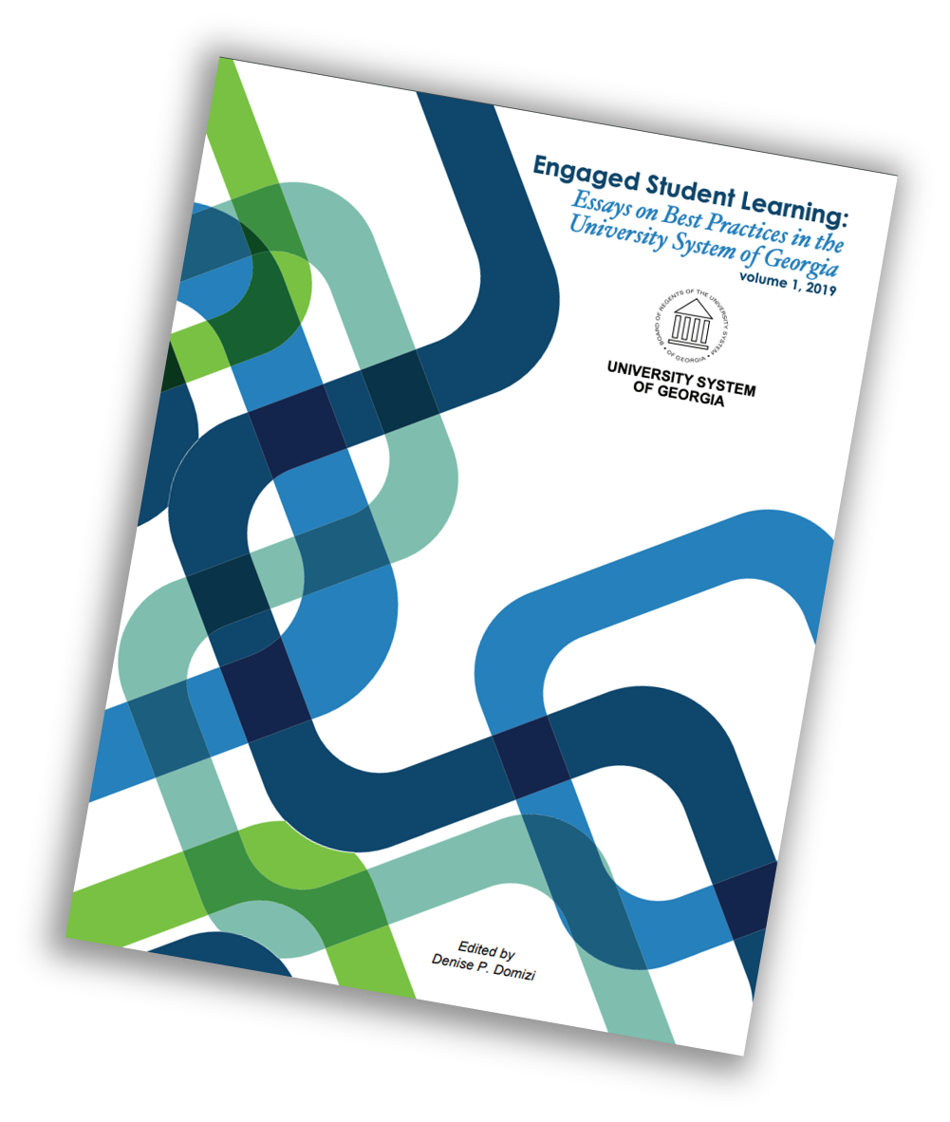
Notes:
Where the essays are heading, first and then hopefully. The first is a Regents publication done by Denise and me; the second is Rowman and Littlefield where I have published a few books. R &L joined Bloomsbury this past year.

Slide 32
Thank you for all of your work this year! Here is the link to submit the reflection: https://form.jotform.com/251214477673056 Questions we can address now?
Jeffery Galle, Ph.D.
Creative Engagement for Faculty
ellag55@gmail.com
https://Jgalle.com (website)
Notes:
Before we close, I want to thank our MS speakers for putting together such fantastic presentations and comments. Thank you!
12 days from now, your reflection is due. Here is the link to the submission portal. What questions do you have?
Then the PHOTO of our group in the Regents building on August 12, 2024

Slide 33
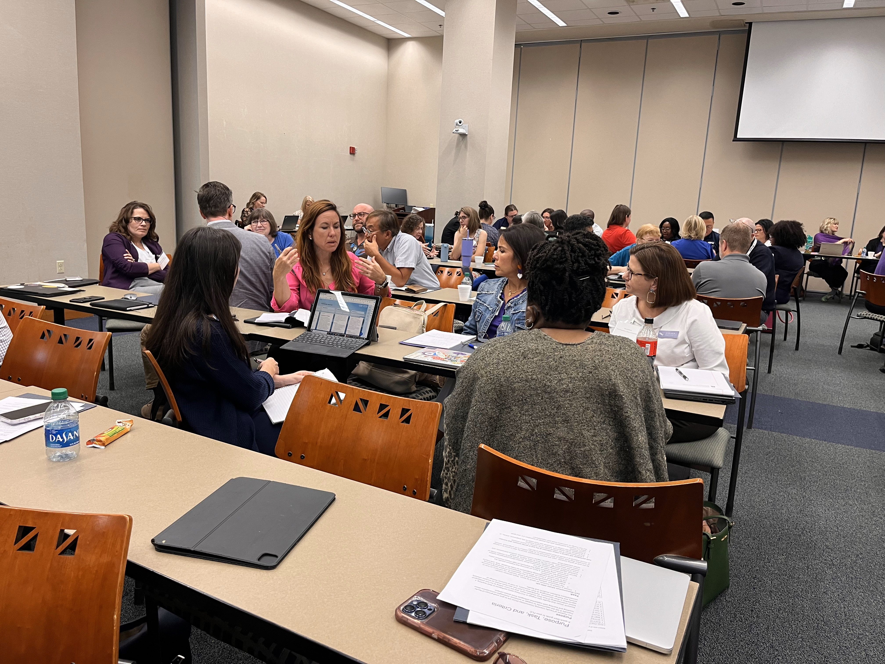
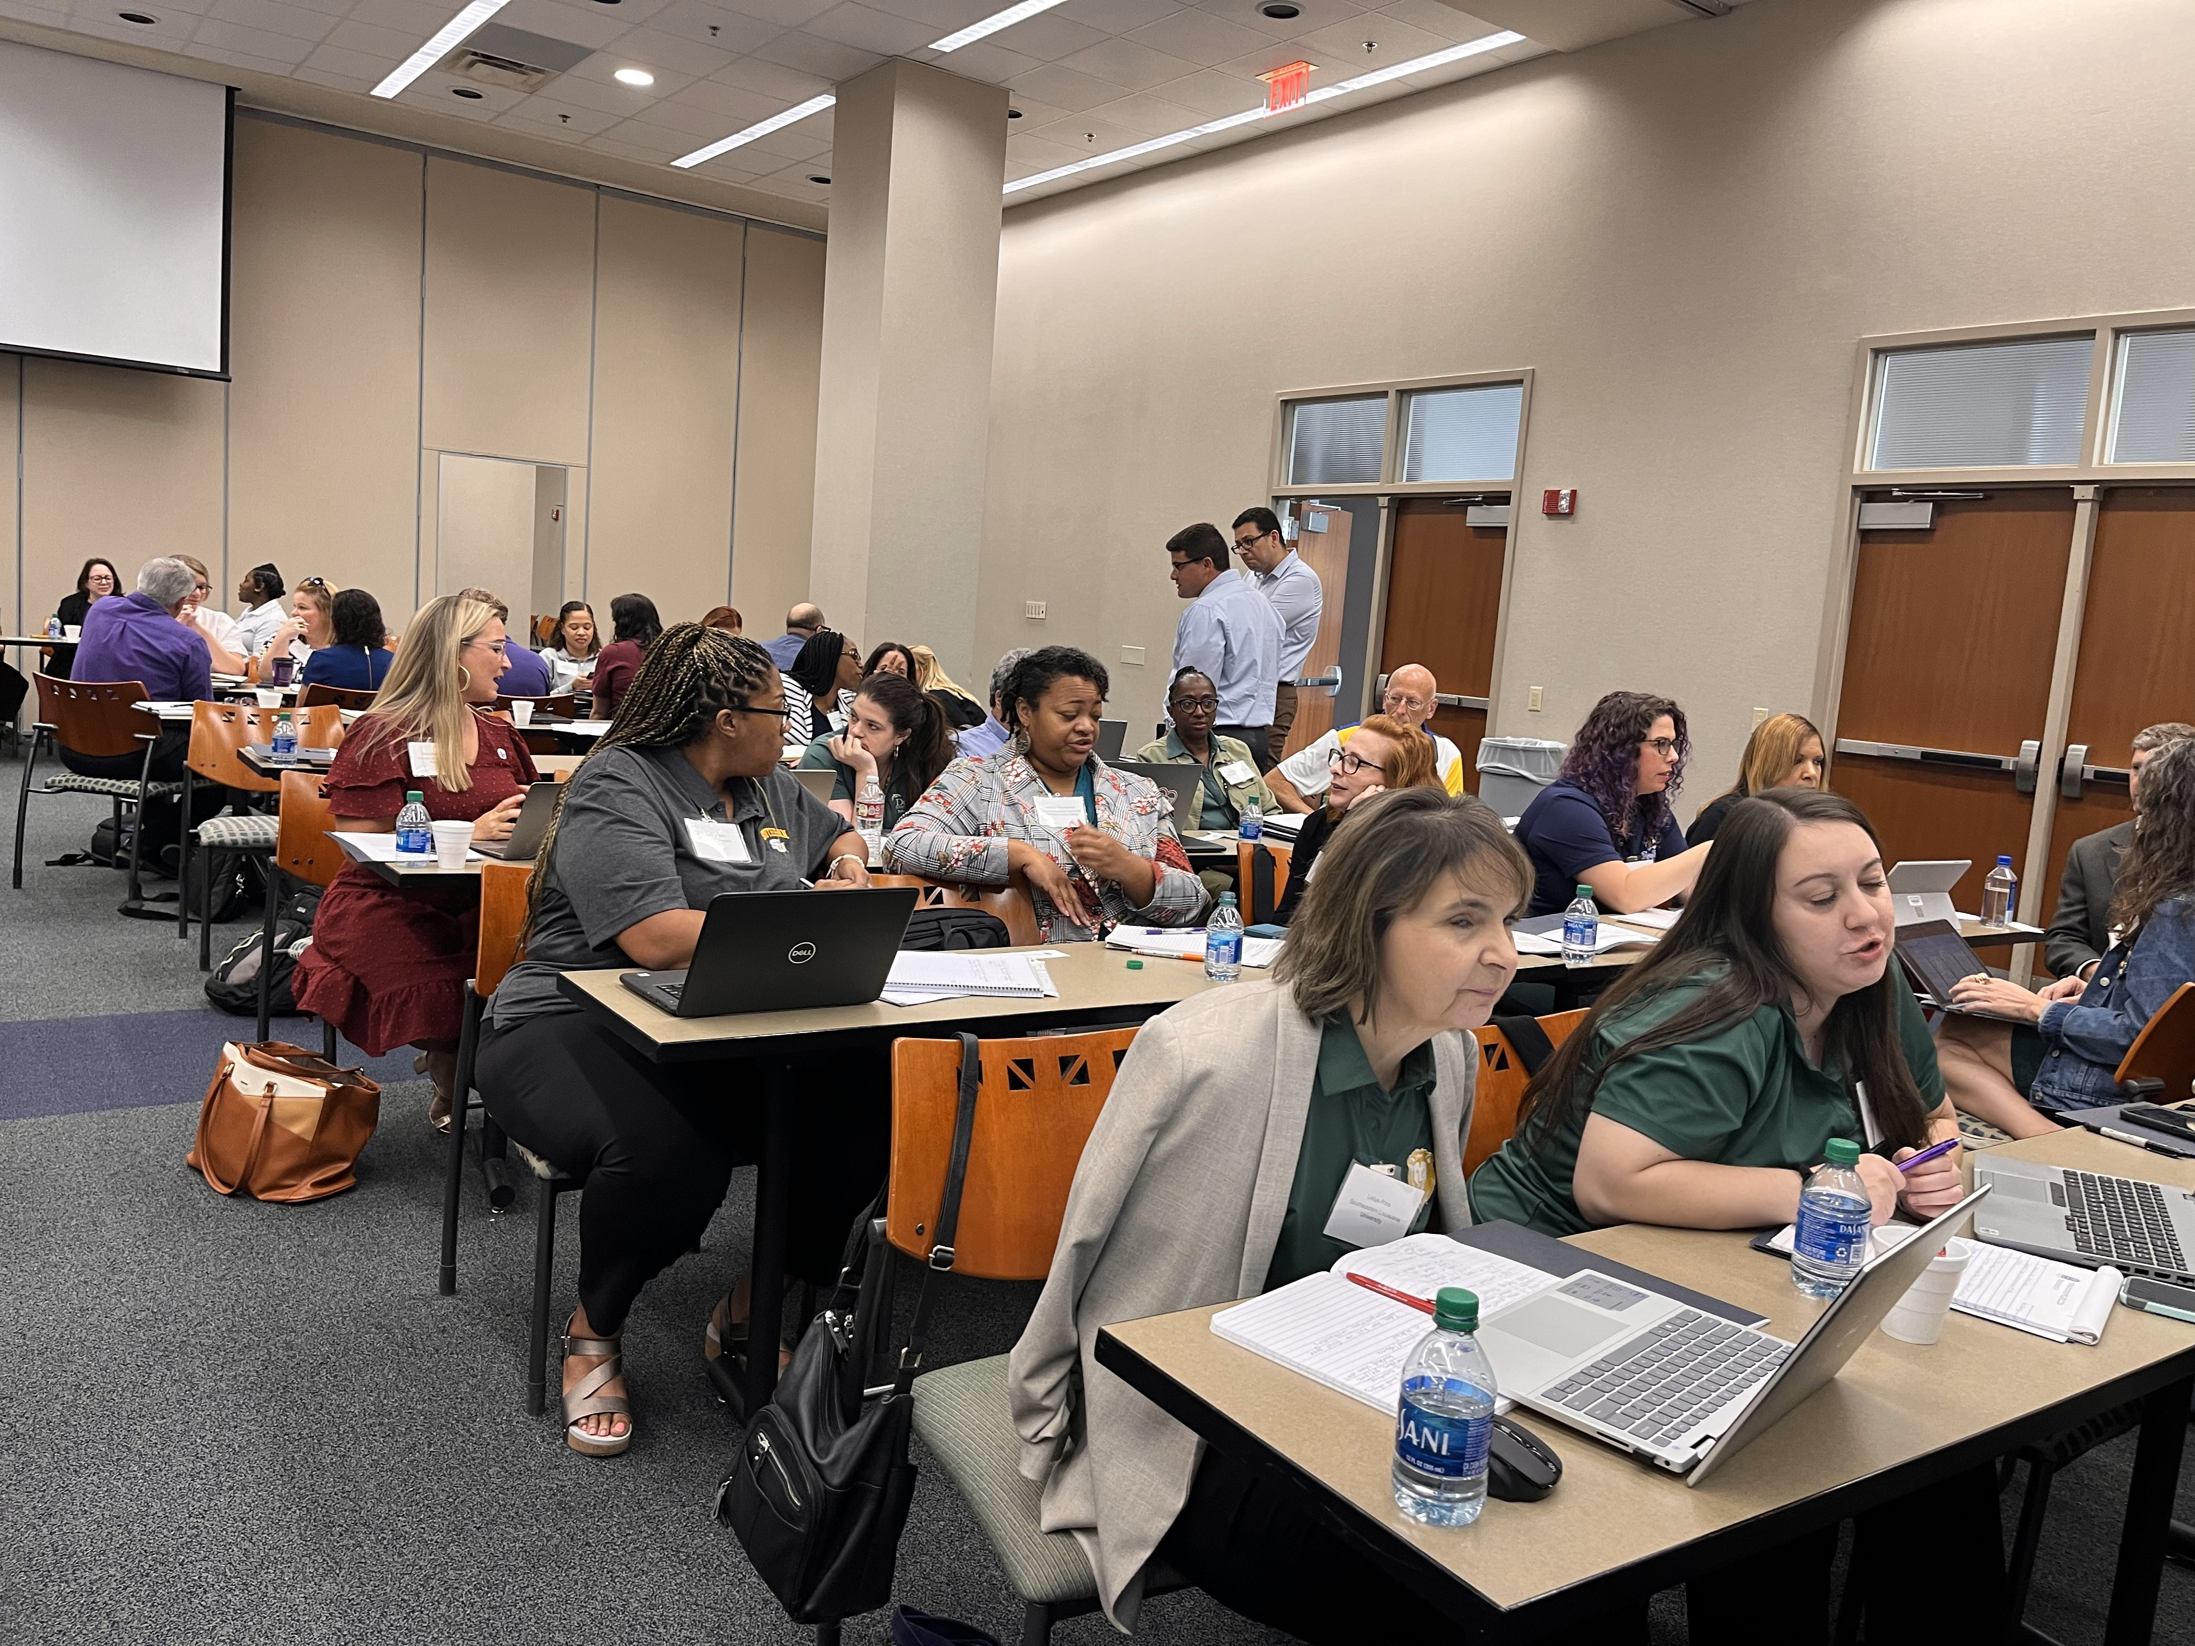
Planning, Writing, Sharing
Notes:
August 12, Board of Regents building, Baton Rouge, like yesterday

